Slide 1

Transformers, GPT and the roadmap to the rapid progress
R K Madhuri

Slide 2

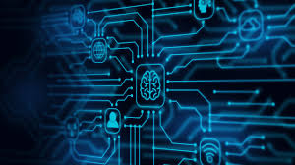
The captivating journey of AI's evolution in language understanding, from DNNs and LSTMs to transformers like BERT and GPT models, is a thrilling advancement.
This progress revolutionizes machine communication, enabling machines to comprehend and generate human-like language, enhancing interactions between humans and machines.

Slide 3
Deep Neural Networks (DNNs) and Their Limitations:
While Deep Neural Networks (DNNs) exhibit power, they encounter limitations, particularly with fixed-dimensional inputs and targets. Long Short-Term Memory (LSTM) architectures have been utilized for sequential tasks, effectively mapping variable-length input sequences to fixed-dimensional vectors and generating output sequences.
Notably, LSTMs were employed in the WMT’14 English to French translation task, achieving a BLEU score of 34.81, surpassing the prior best result of 33.30 from a phrase-based Statistical Machine Translation (SMT) system.

Slide 4
Introduction of the Encoder-Decoder Architecture:
The concept of "Sequence to Sequence Learning with Neural Networks" pioneered the Encoder-Decoder architecture, specifically designed for sequence-to-sequence (seq2seq) tasks like machine translation. These architectures excel at managing variable-length input and output sequences. However, they encountered difficulties when dealing with longer sequences because they rely on a fixed-length context vector, which could result in potential information loss. This limitation prompted further exploration and refinement of the architecture to address these challenges effectively.

Slide 5
Unlocking the Potential of LSTM in Sequence Learning:
Recurrent Neural Networks (RNNs) are tailored for sequential data, yet they grapple with the nuances of varying input and output lengths. Long Short-Term Memory (LSTM) architectures offer a solution by estimating the conditional probability of an output sequence given an input. In our model, we leverage two LSTMs: one dedicated to processing input and the other to generating output, both embedded within a deep architecture comprising four layers. An innovative technique employed involves reversing the word order of the input sentence, a strategy that notably enhances the LSTM's efficacy in facilitating seamless communication between input and output.

Slide 6
Introduction of Transformers: The Game-Changer
The emergence of the Transformer architecture, as presented in the groundbreaking 2017 paper "Attention is All You Need" by Google, heralded a revolutionary paradigm shift in sequence modelling. Unlike previous approaches reliant on recurrent neural network (RNN) cells, the Transformer architecture revolutionized the field by introducing self-attention mechanisms and feed-forward neural networks. This departure from traditional RNN-based methods marked a significant leap forward in the effectiveness and efficiency of sequence modelling.

Slide 7
Key Components of the Transformer Architecture:
Encoder-Decoder Architecture
Self-Attention Mechanism
Multi-Head Attention
Feed-Forward Network
Skip/Residual Connections
Positional Encoding
7.Parallelization and Scalability

Slide 8
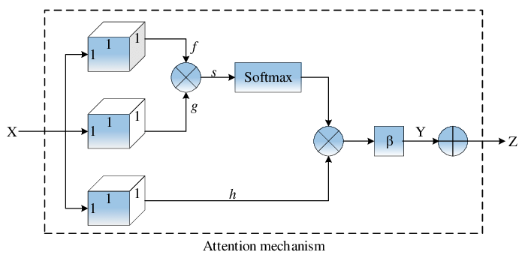
1. Encoder-Decoder Architecture:
Consists of an encoder-decoder structure.
Encoder excels at understanding text.
Decoder excels at generating text.
2. Self-Attention Mechanism:
Enables each word to attend to all other words in the sequence.
Captures global dependencies and eliminates the need for recurrent connections

Slide 9
3. Multi-Head Attention:
Employs multiple parallel attention computations with different learned linear
projections.
Enhances the model’s ability to focus on different parts of the input sequence simultaneously, capturing diverse patterns.
4. Feed-Forward Network:
Applies non-linear transformations to input representations.
Helps the model capture complex patterns and relationships in the input sequences.
5. Skip/Residual Connections:
Enable the network to retain important information from previous layers.
Act as shortcuts allowing information to bypass certain layers, preserving crucial data for later layers.

Slide 10
6. Positional Encoding:
Introduces encodings added to input embeddings to maintain positional information of words without using recurrence.
7. Parallelization and Scalability:
Facilitates parallel computation across the input sequence, resulting in faster training and improved scalability compared to traditional recurrent models.
.

Slide 11
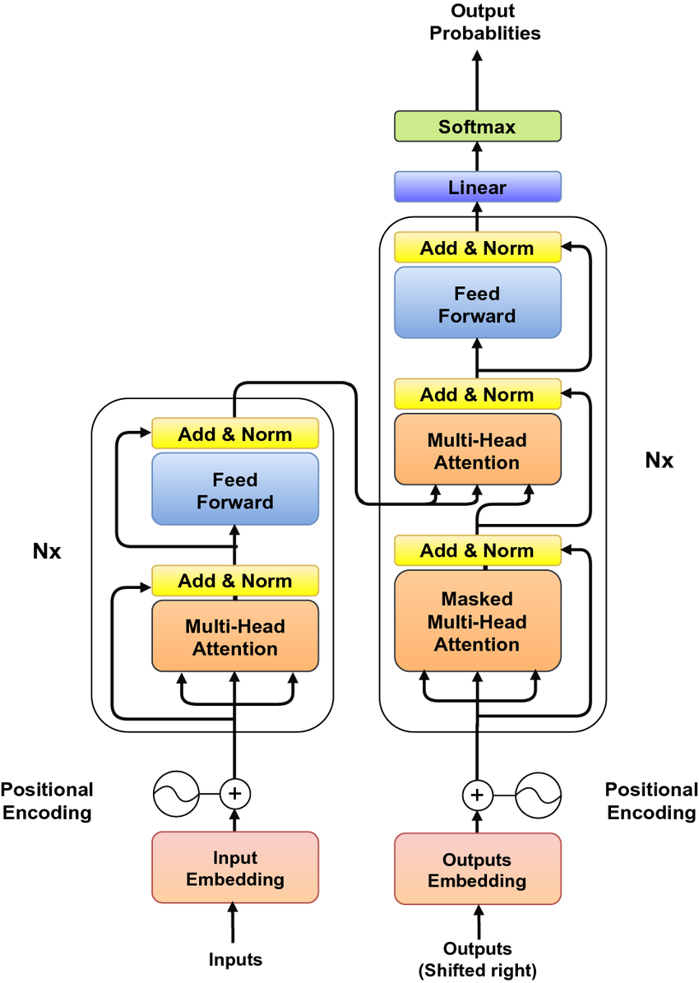
The attention mechanism within the Transformer architecture dynamically assigns weights to different input elements, prioritizing crucial information to enhance performance in translation and similar tasks. This architecture incorporates essential components such as self-attention, multi-head attention, feed-forward networks, skip/residual connections, and positional encodings. Together, these elements contribute to improving effectiveness, scalability, and the ability to capture intricate patterns in data processing.

Slide 12
Importance of Transformers in NLP and Beyond:
Transformers have become increasingly favoured within the realm of natural language processing (NLP) owing to a multitude of advantages they offer
Efficiency in Parallelization:
They exhibit faster training times and superior scalability, particularly notable when handling lengthy sequences, thanks to their inherent parallelization capabilities.
Capturing Long-Range Dependencies:
Unlike recurrent neural networks (RNNs), Transformers excel in capturing long-range dependencies within the data, enhancing their ability to comprehend intricate patterns and relationships across sequences.

Slide 13
Flexibility and Performance:
Demonstrating remarkable versatility, Transformers have consistently achieved state-of-the-art results across various NLP tasks, showcasing their adaptability and high-performance capabilities.
Elimination of Recurrence:
The absence of recurrence simplifies the architecture, rendering it more straightforward to train and optimize, thus streamlining the development and deployment process.
BERT: Bidirectional Encoder Representation from Transformers:
BERT, developed by Google, represents a significant leap forward in natural language processing (NLP) as an Autoencoding Language Model.

Slide 14
Tasks:
BERT demonstrates proficiency across various tasks, including sentiment analysis, named entity recognition, and question answering.
Data:
It was trained on a vast corpus comprising English Wikipedia (2.5 billion words) and Book Corpus (800 million words), providing it with extensive linguistic knowledge.
Training:
Leveraging the Transformer architecture and Google's TPUs for acceleration, BERT's training process spans approximately 4 days with the utilization of around 64 TPUs.
Input Structure:
BERT employs a three-layered token embedding scheme featuring Word Piece Embeddings along with special tokens, enabling it to effectively process and understand input sequences.

Slide 15
Generative Models and Transfer Learning:
Generative models, whether for text, images, or sound, produce output in these respective domains. GPT-1, a pioneering example, was trained to forecast the subsequent word in a sequence based on the preceding words, a task emblematic of Language Models. Operating on the Transformer model architecture, GPT-1 marked a notable advancement beyond the limitations of RNNs in NLP. It excelled at predicting text continuation and underwent fine-tuning for specific NLP tasks, leading to state-of-the-art performance across nine distinct tasks.
In machine learning , pre training entails training a model on a primary task to equip it for performing other tasks with minimal additional training, a concept akin to transfer learning. GPT-1 underwent pre training on various NLP tasks such as question answering, classification, leveraging that transformer architecture.

Slide 16
This approach represented a significant enhancement over RNNs, as Transformers excel at capturing long-range dependencies and parallelizing computations, making them ideal for processing large datasets efficiently.
During pre-training, GPT-1 learned to predict the next word in a given text sequence. Subsequently, OpenAI fine-tuned GPT-1 for specific NLP tasks, achieving outstanding performance across nine tasks. While GPT-1 was made available for direct usage, its output quality is comparatively lower than models like ChatGPT, which is based on GPT-3.
Fine-tuning GPT-1 involves customizing it for specific tasks, such as sentiment classification. This process typically includes importing the model and tokenizer, introducing a padding token, and incorporating the target dataset for further refinement.

Slide 17
Conclusion:
In summary, the journey from DNNs to LSTMs and finally to Transformers illustrates the swift progress in sequence modelling and natural language processing (NLP). Transformers, renowned for their efficiency and scalability, have emerged as a cornerstone in contemporary NLP methodologies.
GPT-1, a product of this evolutionary trajectory, underscores the potency of generative models and transfer learning within the realm of NLP. As we venture further into the frontier of AI generation, these breakthroughs propel us towards accelerated advancements, empowering machines to comprehend and produce human-like text with unprecedented efficacy.

Slide 18


